Slide 1
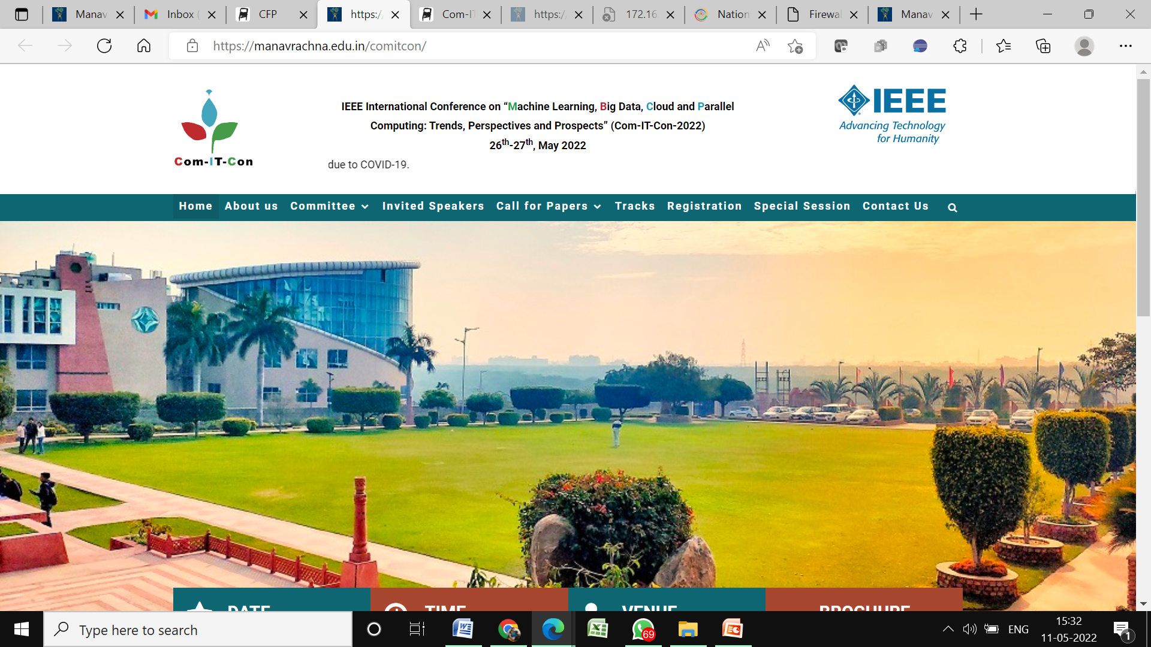

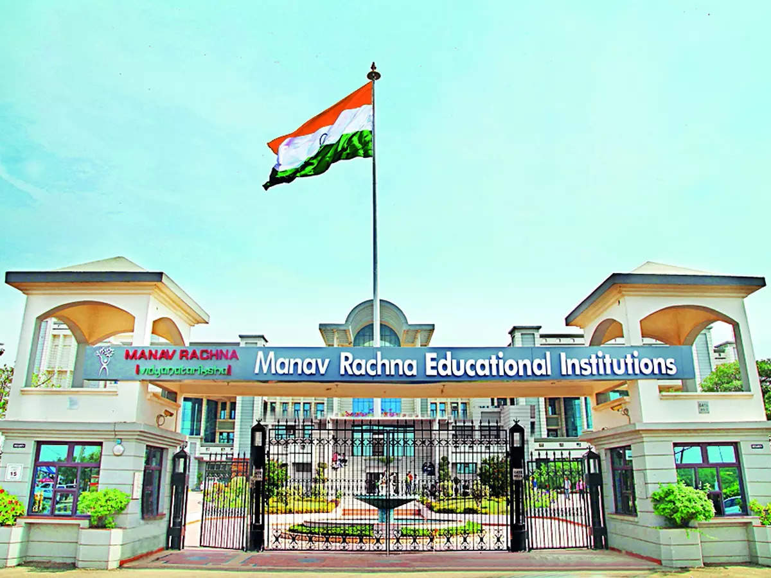
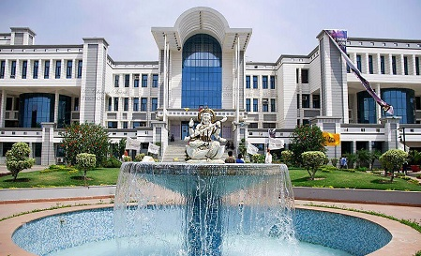
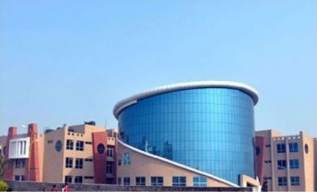
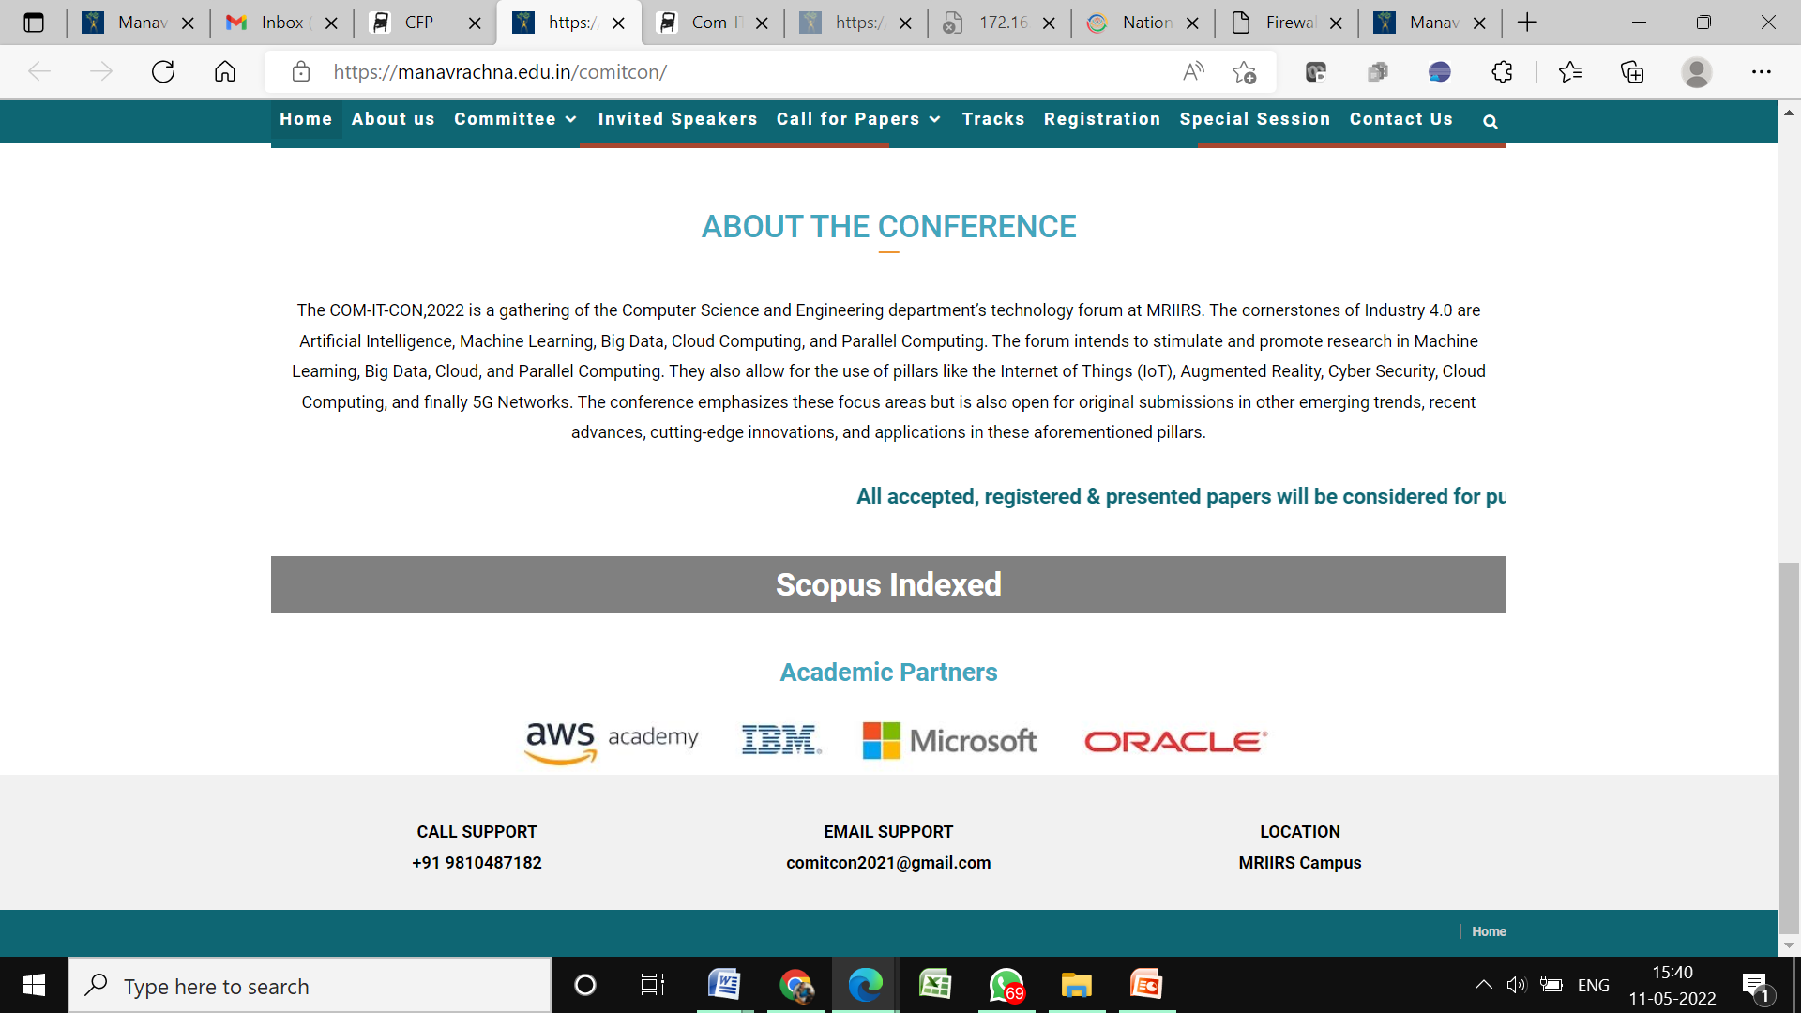


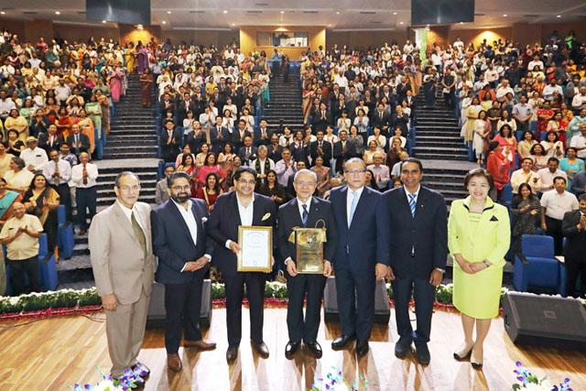
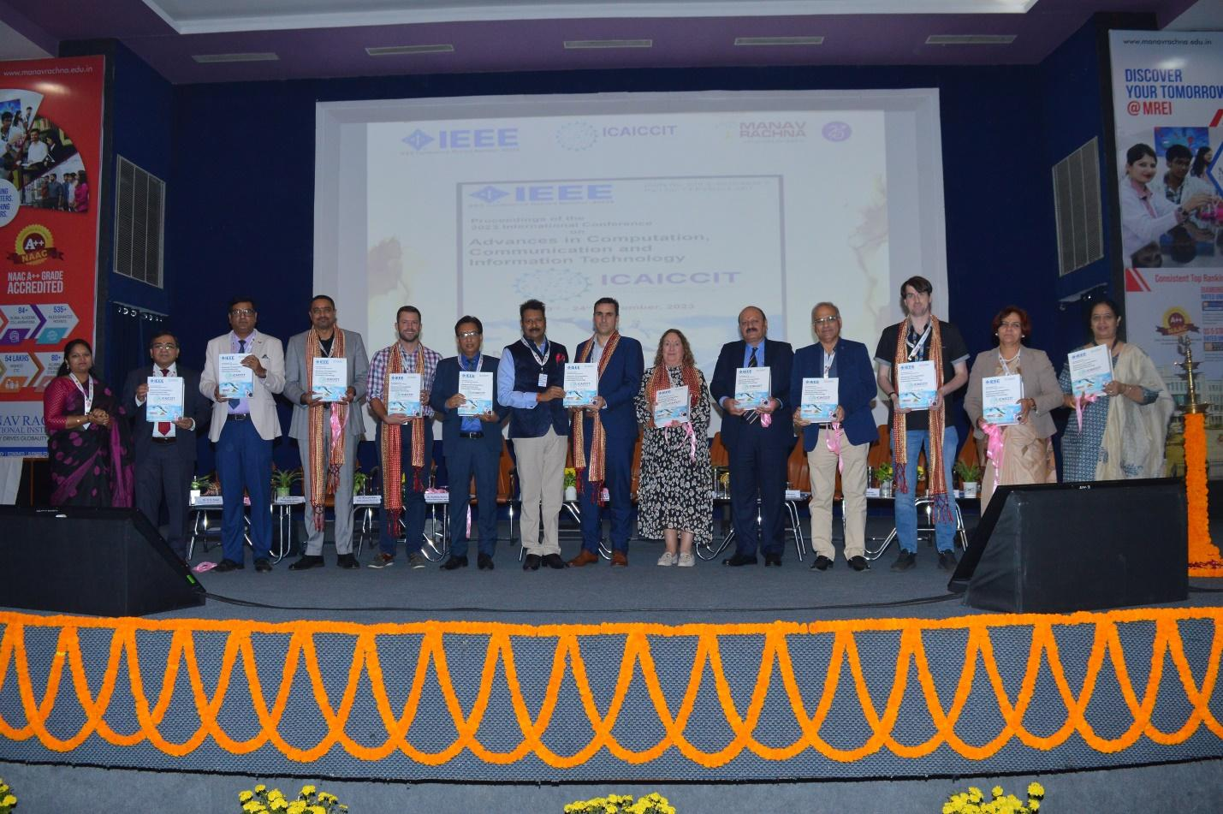
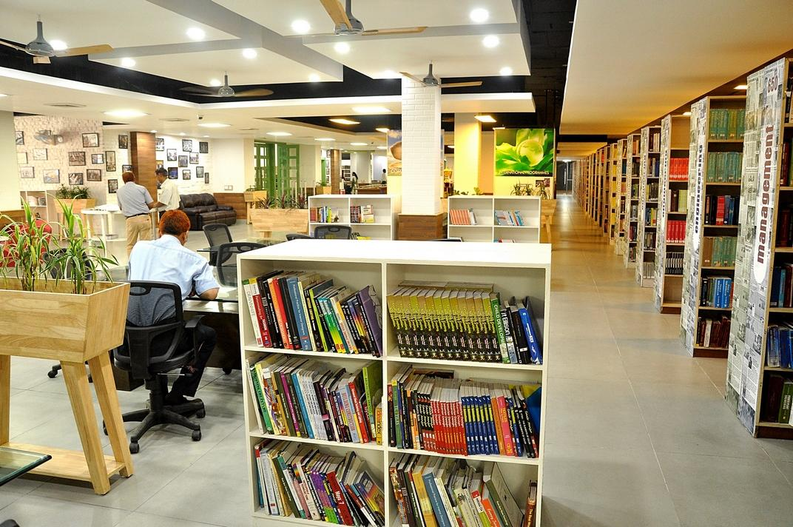
ICAICCIT-2025, 3rd International conference on Advances in Computing, Communication and Information Technology, technically Co-Sponsored by IEEE Delhi SECTION (IEEE record no # 68829)
on 31st Oct & 1st Nov. 2025

Slide 2
Performance-Driven Text Classification on
MovieLens-100K Using FLAN-T5 and BART
Paper id: ICAICCIT_0579
Presented by
Atmakuri Jagadeesh
Atmakuri Jagadeesh, Shaik Mohammad Farooq, Shaik Madeena Noushik, Nalabolu Balakrishna Reddy,
Syed Rizwana, Moturi Sireesha
Narasaraopeta Engineering College, Narasaraopet
Yerrarapu Sravani Devi
G. Narayanamma Institute of Technology Science(women), Hyderabad

Slide 3
Index -
Introduction
Problem Statements
Objectives
Literature Review
Methodology
Result & Discussion
Conclusion & Future Scope
References

Slide 4
Introduction:
Movie recommendation systems help users find relevant content.
Traditional methods like collaborative filtering face issues such as cold-start, sparsity, and
lack of context.
Large Language Models (LLMs) improve understanding of text through semantic analysis.
This study uses FLAN-T5 and BART on the MovieLens-100K dataset for genre prediction.
The framework combines summary generation, zero-shot classification, and LIME-based
explanations for better accuracy and transparency.

Slide 5
Problem Statements:
Traditional recommendation systems depend on user history and metadata.
They face cold-start and data sparsity problems.
Lack of contextual understanding reduces recommendation quality.
Most models offer low interpretability — users can’t see why items are recommended.
There is a need for an accurate and explainable text-based framework using transformer
models to improve genre prediction and recommendations.

Slide 6
Objectives:
Develop a text classification framework for movie genre prediction.
Use FLAN-T5 to generate concise movie summaries.
Apply BART for zero-shot genre classification.
Improve accuracy and reduce dependency on user history.
Enhance model interpretability using LIME explanations.
Demonstrate the strength of transformer-based NLP models in sparse-text scenarios.

Slide 7
Literature Review:
Existing Research:
Earlier methods like collaborative filtering and CNN/RNN models improved accuracy but
required large datasets.
Hybrid and graph-based models captured complex user–item relations but faced scalability
issues.
Transformer-based models introduced context awareness and semantic understanding in
recommendations.
Few studies explored text-based inputs (e.g., subtitles or summaries) with zero-shot learning.
This work bridges that gap using FLAN-T5 and BART for genre prediction with better
performance and interpretability.

Slide 8
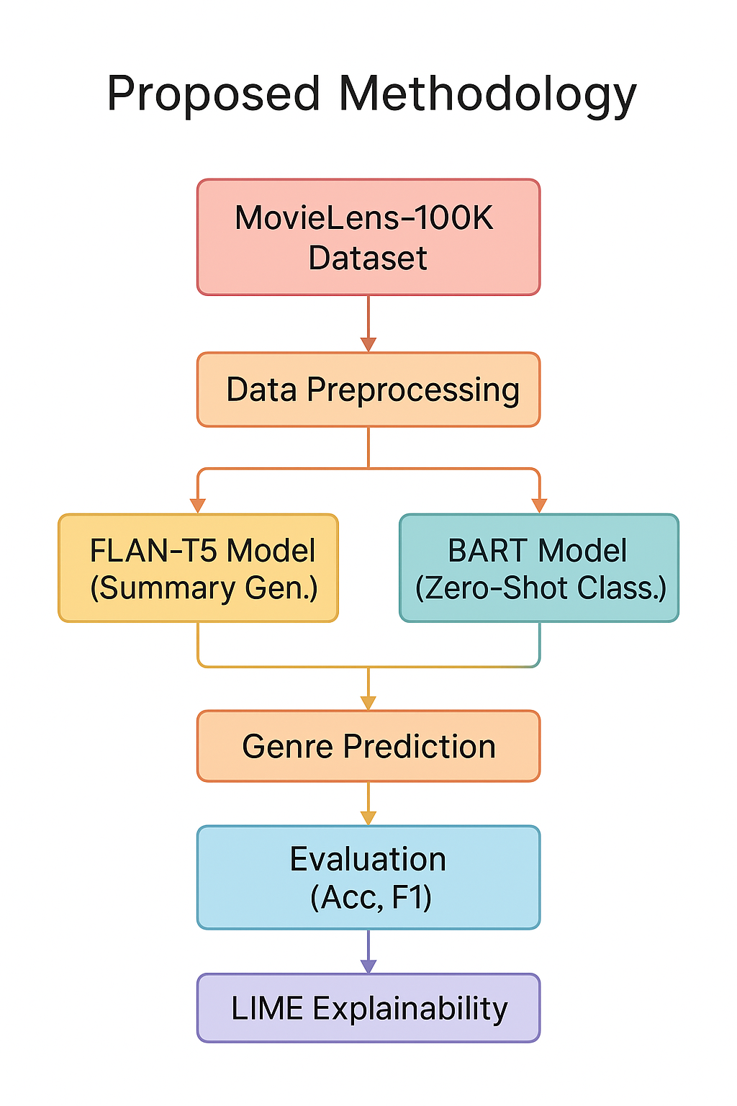
Methodology:
Pipeline Overview:
1. Dataset: MovieLens-100K, containing movie titles, genres,
and user tags.
2. Data preprocessing – cleaning, text normalization, and
tokenization.
3. FLAN-T5 generates movie summaries from textual data.
4. BART performs zero-shot genre classification on generated
summaries.
5. Results compared using accuracy, precision, recall, and F1-
score.
6. LIME provides explanations for model predictions to ensure
transparency.

Slide 9
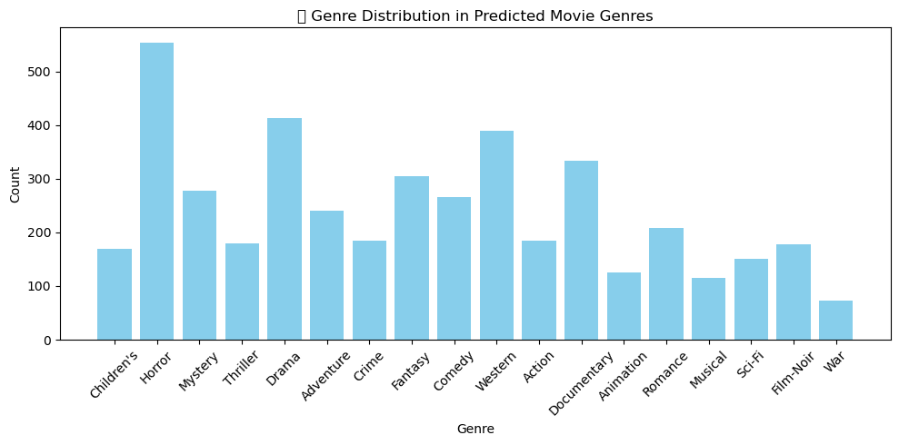
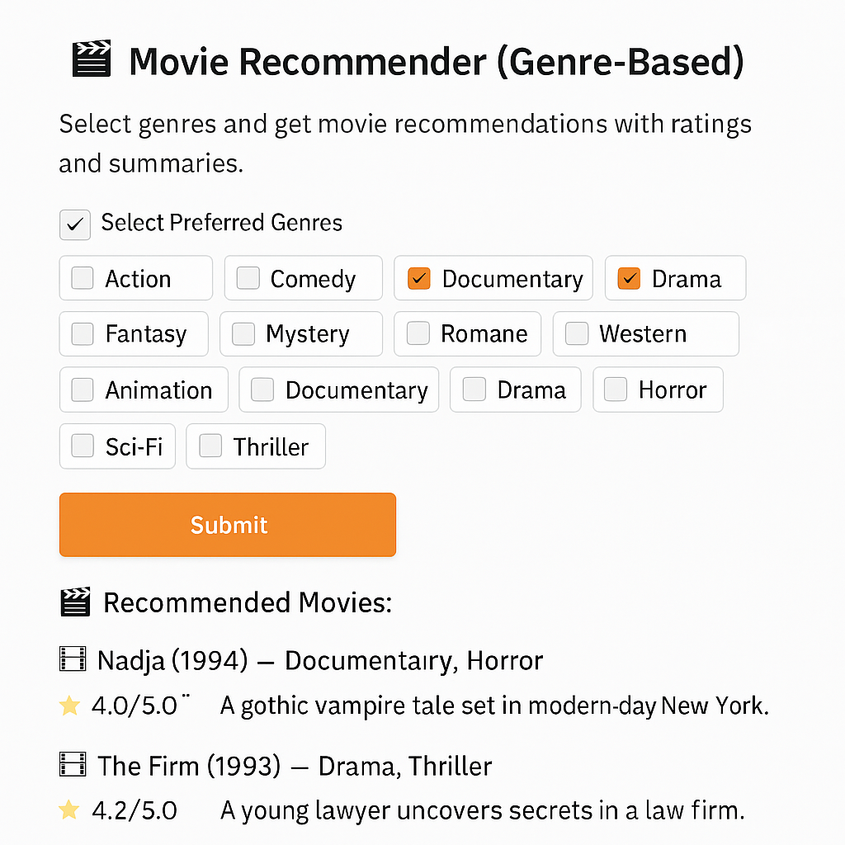
Result & Discussion:
FLAN-T5 generated meaningful and concise movie summaries.
BART achieved accurate multi-genre predictions using zero-shot learning.
FLAN-T5 outperformed BART with higher precision, recall, and F1-score.
Top-5 movies identified by genre preference matched ground-truth data.
Genre-wise trends: Drama, Horror, and Western appeared most frequently.
LIME explanations improved interpretability and user trust in recommendations.

Slide 10
Model Performance Evaluation:
Both FLAN-T5 and BART models were evaluated using the MovieLens-100K dataset.
FLAN-T5 outperformed BART in all metrics:
- Precision: 0.89
- Recall: 0.87
- F1-score: 0.85
- Accuracy: ~92%
BART achieved slightly lower results with an F1-score of 0.82.
Model | Accuracy (%) | Precision | Recall | F1-Score
FLAN-T5 | 92 | 0.89 | 0.87 | 0.85
BART | 88 | 0.84 | 0.81 | 0.82

Slide 11
Conclusion & Future Scope:
Developed a dual-model framework using FLAN-T5 and BART for movie genre prediction.
FLAN-T5 achieved the best results with higher accuracy and interpretability.
The system effectively addressed sparsity and cold-start issues in recommendations.
LIME improved explainability and user trust in predictions.
Future work: apply on larger, balanced datasets, integrate video/audio features, and test
lightweight models for real-time recommendations.

Slide 12
References:
Z. Chen et al., “Collaborative Filtering Network with PMF for Movie Suggestions,” IEEE TKDE, 2024.
H. Liu et al., “Multi-modal CNNs for Movie Recommendation Using Content Features,” IEEE Access, 2023.
Y. Jin et al., “A Transformer-MLP Hybrid Framework for Movie Recommendation,” ACM RecSys, 2025.
S. Longpre et al., “The FLAN Collection: Designing Data and Methods for Effective Instruction Tuning,” ICML, 2023.
S. Raj et al., “Transformative Movie Discovery: Large Language Models for Recommendation and Genre Prediction,” IEEE Access, 2024.

Slide 13
THANK YOU

